Slide 1
COMPUTER ORGANIZATION AND ARCHITECTURE
Prof. (Dr.) Rijwan Khan
Department of Computer Science and Engineering
School of Computing
Galgotias University, G. B. Nagar

Slide 2
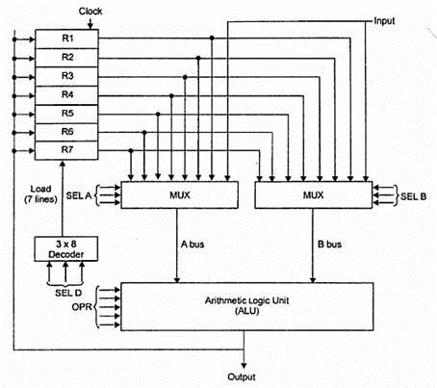
GENERAL RESISTER ORGANIZATION

Slide 3
EXAMPLE:
To perform the operation R3 = R1+R2 We have to provide following binary selection variable to the select inputs.4
1. SEL A : 001 -To place the contents of R1 into bus A.
2. SEL B : 010 - to place the contents of R2 into bus B
3. SEL OPR : 10010 – to perform the arithmetic addition A+B
4. SEL REG or SEL D : 011 – to place the result available on output bus in R3.

Slide 4
Register and multiplexer input selection code
Binary code | SELA | SELB | SEL-D or SEL-REG
000 | Input | Input | ---
001 | R1 | R1 | R1
010 | R2 | R2 | R2
011 | R3 | R3 | R3
100 | R4 | R4 | R4
101 | R5 | R5 | R5
110 | R6 | R6 | R6
111 | R7 | R7 | R7

Slide 5
Operation with symbol
Operation selection code | Operation | symbol
0000 | Transfer A | TSFA
0001 | Increment A | INC A
0010 | A+B | ADD
0011 | A-B | SUB
0100 | Decrement A | DEC
0101 | A AND B | AND
0110 | A OR B | OR
0111 | A XOR B | XOR
1000 | Complement A | COMA
1001 | Shift right A | SHR
1010 | Shift left A | SHL

Slide 6
CONTROL WORD
The combined value of a binary selection inputs specifies the control word.
• It consist of four fields SELA,SELB,and SELD or SELREG contains three bit each and SELOPR field contains four bits thus the total bits in the control word are 13-bits.
SEL A | SELB | SELREG OR SELD | SELOPR
FORMATE OF CONTROL WORD

Slide 7
The three bit of SELA select a source registers of the a input of the ALU.
The three bits of SELB select a source registers of the b input of the ALU.
The three bits of SELED or SELREG select a destination register using the decoder.
The four bits of SELOPR select the operation to be performed by ALU.
CONTROL WORD FOR OPERATION R2 = R1+R3
SEL A | SEL B | SEL- D OR SEL- REG | SEL -OPR
001 | 011 | 010 | 0010
Note: Control words for all micro operation are stored in the control memory
Example:
MICROOPERATION | SEL.A | SEL.B | SEL D OR SEL REG | SELOPR | CONTROL WORD
R2 = R1+R3 | R1 | R3 | R2 | ADD | 001 | 011 | 010 | 0010

Slide 8


